Slide 2
ML Introduction for Game Devs: Recognizing Handwritten Digits with a Small Neural Network in Plain C++
Alan Wolfe – SEED Future Graphics

Slide 3
Overview
1. Multi-Layer Perceptrons
4. Recipe For Recognizing Hand Drawn Digits
MLPs are the classic type of neural network.
Just like momma used to make!
Standalone C++ to train a MLP.
C++ DX12 Application to see it in action.
2. Gradient Descent
Optimization is finding the x that gives the lowest y=f(x) value. Gradient descent is starting at a random x and rolling downhill.
3. Three Methods For Calculating Gradients
Finite Differences (easy mode), Dual Numbers, and Backpropagation (pro mode).
Code And Exercises are at https://github.com/electronicarts/cpp-ml-intro/

Slide 4
Multi-Layer Perceptrons

Slide 5
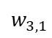
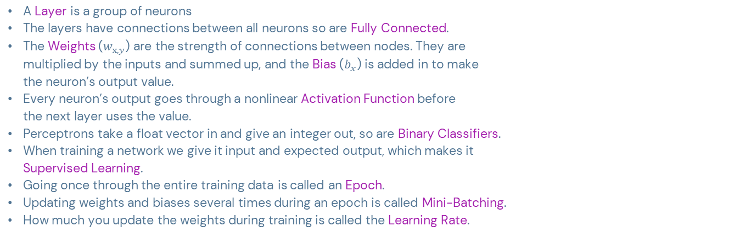
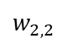
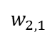
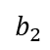
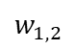
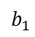
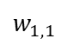
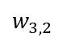
Multi-Layer Perceptrons
Input Layer
Output Layer
Input 1
Terminology
$$w_{1,1}$$
$$w_{1,2}$$
Output 1
A Layer is a group of neurons
The layers have connections between all neurons so are Fully Connected.
The Weights ($w_{x,y}$) are the strength of connections between nodes. They are multiplied by the inputs and summed up, and the Bias ($b_{x}$) is added in to make the neuron’s output value.
Every neuron’s output goes through a nonlinear Activation Function before the next layer uses the value.
Perceptrons take a float vector in and give an integer out, so are Binary Classifiers.
When training a network we give it input and expected output, which makes it Supervised Learning.
Going once through the entire training data is called an Epoch.
Updating weights and biases several times during an epoch is called Mini-Batching.
How much you update the weights during training is called the Learning Rate.
$$b_{1}$$
Input 2
$$w_{2,1}$$
$$w_{2,2}$$
Output 2
$$b_{2}$$
Input 3
$$w_{3,1}$$
$$w_{3,2}$$
Notes:
If the perceptron gave a floating point vector out, it would be regression. AKA mapping inputs to outputs, function fitting.
Unupervised learning would be more like clustering. Group data into buckets, without being told how to define those buckets.
More on weights, biases, and activation functions in a second.

Slide 6
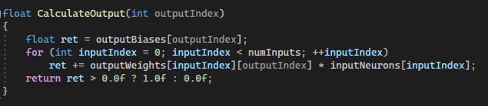
Multi-Layer Perceptrons
Input Layer
Output Layer
Input 1
Perceptron Inference (Evaluation / Execution)
$$w_{1,1}$$
$$w_{1,2}$$
Output 1
$$b_{1}$$
Calculating Output[i]:
Sum up Input[j] * Weight[j] for all input neurons.
Add the bias for output node: Bias[i].
Put that through the activation function (return sign).
Input 2
$$w_{2,1}$$
$$w_{2,2}$$
Output 2
$$b_{2}$$
Input 3
$$w_{3,1}$$
$$w_{3,2}$$

Slide 7
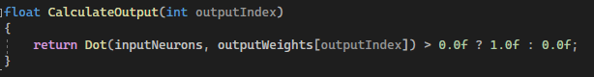
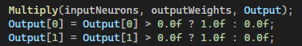
Multi-Layer Perceptrons
Input Layer
Output Layer
Input 1
Perceptron Inference As Dot Product
$$w_{1,1}$$
Let Input be (Input, 1)
Let Weights be (Weights, Bias)
Output[i] = Sign(Dot(Input, Weights[i]))
Getting both outputs is 2 dot products, aka 1 matrix multiply.
$$w_{1,2}$$
Output 1
$$b_{1}$$
Input 2
$$w_{2,1}$$
$$w_{2,2}$$
Output 2
$$b_{2}$$
Input 3
$$w_{3,1}$$
$$w_{3,2}$$
Notes:
Sort of like homogeneous coordinates in rendering.
This is why neural network inference can be so fast. It’s just a bunch of simple non linear activation functions done to the results of dot products.

Slide 8

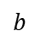
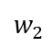
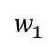
Multi-Layer Perceptrons
Input 1
$$w_{1}$$
Exercise 1: Perceptron Logic Gates
Output
$$b$$
Input 2
Are you able to find the weight and bias values to make these logic gates?
OR
AND
NOT (only one input neuron)
XOR
More detailed instructions at:
https://github.com/electronicarts/cpp-ml-intro/tree/main/Exercises/1_LogicGates
$$w_{2}$$
For AND, OR, XOR Output = Sign(Input1 * Weight1 + Input2 * Weight2 + Bias)
Input
$$w$$
Output
$$b$$
For NOT
Output = Sign(Input * Weight + Bias)
Notes:
More detailed instructions are up on gitlap.
Pause the video and give it a try.

Slide 9


Multi-Layer Perceptrons
Exercise 1: Perceptron Logic Gate Solution - OR
Input 1
Input 1 | Input 2 | Sum | Sign()
0 | 0 | 0 | 0
0 | 1 | 1 | 1
1 | 0 | 1 | 1
1 | 1 | 2 | 1
OR Output = Sign(Input1 + Input2)
1
Output
$$0$$
Input 2
$$1$$

Slide 10
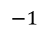
Multi-Layer Perceptrons
Exercise 1: Perceptron Logic Gate Solution - AND
Input 1
Input 1 | Input 2 | Sum | Sign()
0 | 0 | -1 | 0
0 | 1 | 0 | 0
1 | 0 | 0 | 0
1 | 1 | 1 | 1
1
AND Output = Sign(Input1 + Input2 - 1)
Output
$$−1$$
Input 2
$$1$$

Slide 11

Multi-Layer Perceptrons
Exercise 1: Perceptron Logic Gate Solution - NOT
Input | Sum | Sign()
0 | 1 | 1
1 | 0 | 0
NOT Output = Sign(Input * -1 + 1)
Input
Output
$$−1$$
$$1$$

Slide 12



Multi-Layer Perceptrons
Exercise 1: Perceptron Logic Gate Solution - XOR
Input 1
Hidden 1
Input 1 | Input 2 | Hidden1 | Hidden2 | Output
0 | 0 | 0 | 0 | 0
0 | 1 | 0 (-1) | 1 | 1
1 | 0 | 1 | 0 (-1) | 1
1 | 1 | 0 | 0 | 0
1
$$0$$
1
-1
Output
$$0$$
Input 2
-1
Hidden 2
$$0$$
$$1$$
1
XOR Hidden1 = Sign(Input1 – Input2)
Hidden2 = Sign(Input2 – Input1) Output = Sign(Hidden1 + Hidden2)
Intuition:
Hidden1 is 1 if only Input1 is 1
Hidden2 is 1 if only Input2 is 1
Output = Hidden1 OR hidden2
Notes:
XOR isn’t possible without adding a hidden layer between input and output.
Adding one or more hidden layers is what turns a single layer perceptron into a multi layer perceptron, and makes it more powerful.
You can have as many hidden layers as you want, and they can be whatever size you want.
More neurons means longer training times though, and also makes inference take more calculations.

Slide 13
Gradient Descent

Slide 14
Gradient Descent
Training a Multi Layer Perceptron
Goal:
When you give an input and get an output, the Cost Function says how wrong the output is for that input.
You want to find weight and bias values that give the lowest cost function for your training data.
Two Methods of Training:
Randomly generate a lot of neural networks and keep the best one.
Start with a randomized network and try to improve it.
Notes:
The first way is possible, especially for smaller neural networks, but for best results, and for larger networks, you really want to go the second way.

Slide 15
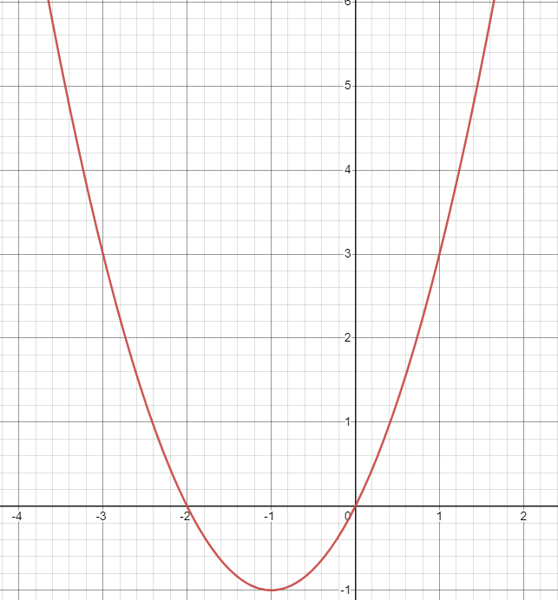
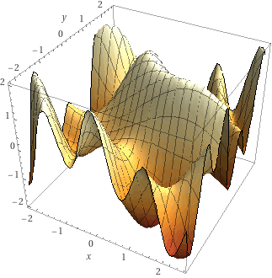
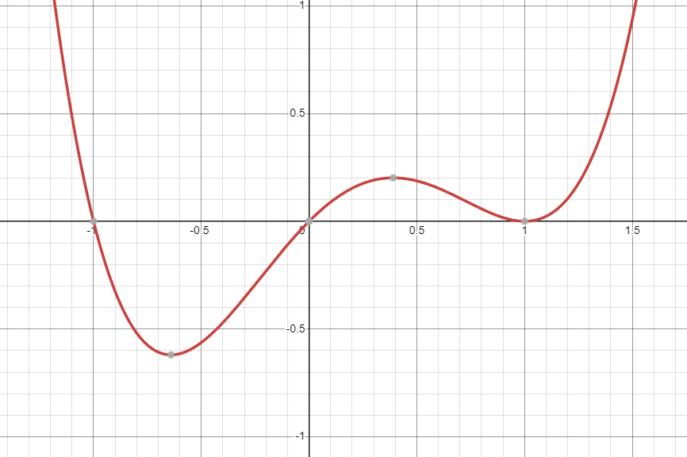


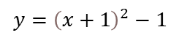
Gradient Descent
Optimization A Cost Function: Finding The Lowest Point On The Graph
Easy Mode
What Now?
Watch Out For Local Minima
$$y={\left(x+1\right)}^{2}−1$$
y’ = 2x+2
2x+2 = 0
x = -1
Drop a ball randomly
Let it roll downhill
Also: how far to step? A technique called ADAM adds momentum and adaptive step sizes.
Notes:
You can use calculus to solve basic functions.
Cost functions take each weight and bias as a parameter though, which means it is highly dimensional and complex equation, but it always returns a single cost value. You are trying to find the location of the lowest cost.
Intuitively, you can drop a ball at a random point on the graph and let it roll down hill to find a minimum.
You have to watch out for local minima, but in higher dimensions this isn’t as big of a problem as you’d think it is. Usually a minimum in one dimension lets you roll sideways down another dimension.

Slide 16
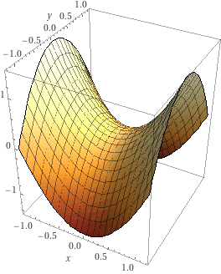
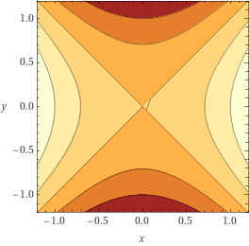
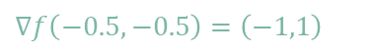
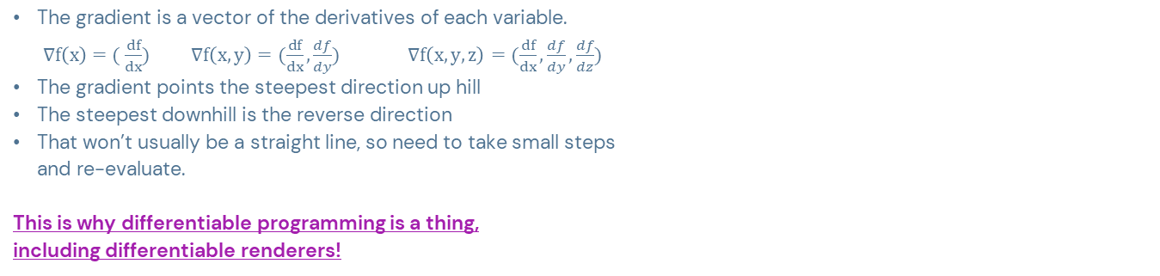

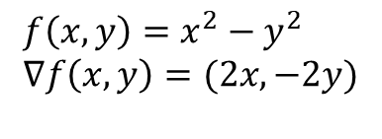
Gradient Descent
What Is “Downhill” Mathematically? The Gradient!
$$f\left(x,y\right)=x^{2}−y^{2} \\ ∇f\left(x,y\right)=(2x,−2y)$$
The gradient is a vector of the derivatives of each variable.
$∇f\left(x\right)=( \frac{df}{dx})$ $∇f\left(x,y\right)=(\frac{df}{dx},\frac{df}{dy})$ $∇f\left(x,y, z\right)=(\frac{df}{dx},\frac{df}{dy},\frac{df}{dz})$
The gradient points the steepest direction up hill
The steepest downhill is the reverse direction
That won’t usually be a straight line, so need to take small steps and re-evaluate.
This is why differentiable programming is a thing, including differentiable renderers!
$$∇f\left(−0.5,0\right)=\left(−1,0\right)$$
$$∇f\left(−0.5,−0.5\right)=\left(−1,1\right)$$

Slide 17
Three Methods For Calculating Gradients

Slide 18
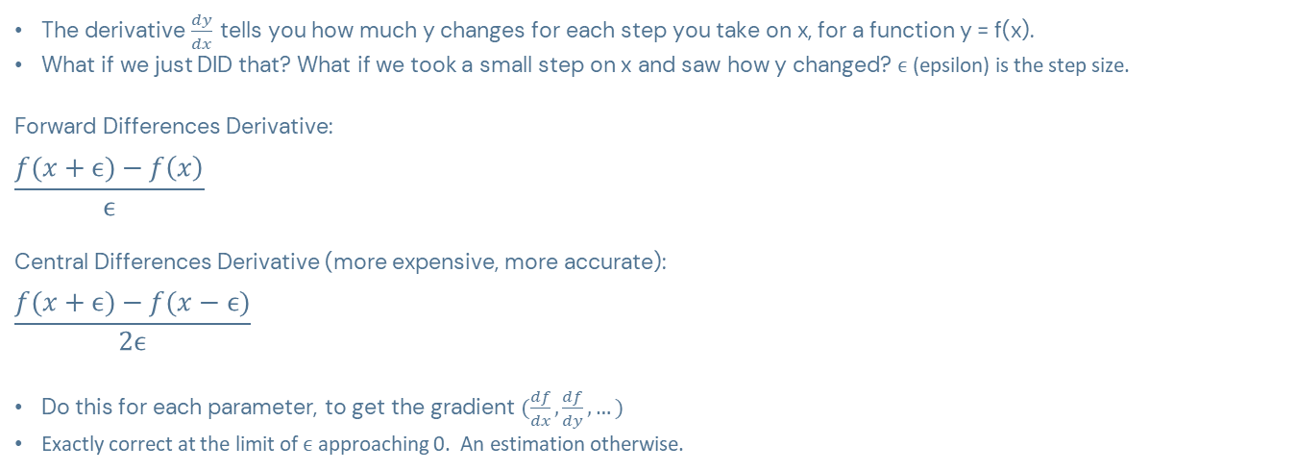
Calculating Gradients
Finite Differences – Easy Mode Gradients
The derivative $\frac{dy}{dx}$ tells you how much y changes for each step you take on x, for a function y = f(x).
What if we just DID that? What if we took a small step on x and saw how y changed? $ϵ$ (epsilon) is the step size.
Forward Differences Derivative:
$$\frac{f(x+ϵ)−f\left(x\right)}{ϵ}$$
Central Differences Derivative (more expensive, more accurate):
$$\frac{f(x+ϵ)−f(x−ϵ)}{2ϵ}$$
Do this for each parameter, to get the gradient $(\frac{df}{dx},\frac{df}{dy},…)$
Exactly correct at the limit of $ϵ$ approaching 0. An estimation otherwise.
Notes:
Forward differences is often cheaper than central differences because you often already have f(x), especially if evaluating this for multiple parameters
Central differences then requires you to do twice as many function evaluations, but it is more accurate. It gives you the exact result for quadratic equations, for example.
Finite differences isn’t the most efficient way to get a gradient, but it is very simple to do and to understand

Slide 19
Calculating Gradients
Exercise 2 - Finite Differences
Exercises are at: https://github.com/electronicarts/cpp-ml-intro/tree/main/Exercises/2_FiniteDifferences
Implement forward or central differences
Some other experiments to understand the capabilities and limitations.
Notes:
Not going to talk about results, there’s a solutions document that you can check out, but that exercise was about self driven exploration. Hopefully you learned some things from it!

Slide 20
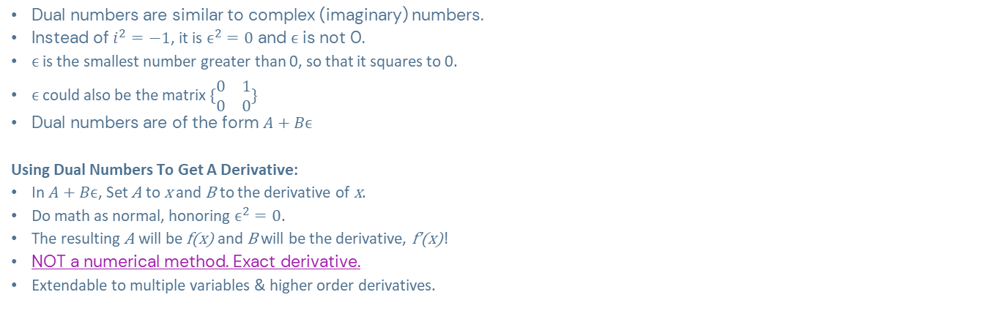
Calculating Gradients
Dual Numbers – Forward Mode Automatic Differentiation
Dual numbers are similar to complex (imaginary) numbers.
Instead of $i^{2}=−1$, it is $ϵ^{2}=0$ and $ϵ$ is not 0.
$ϵ$ is the smallest number greater than 0, so that it squares to 0.
$ϵ$ could also be the matrix $\{\begin{matrix}0 & 1 \\ 0 & 0\end{matrix}\}$
Dual numbers are of the form $A+Bϵ$
Using Dual Numbers To Get A Derivative:
In $A+Bϵ$, Set A to x and B to the derivative of x.
Do math as normal, honoring $ϵ^{2}=0$.
The resulting A will be f(x) and B will be the derivative, f’(x)!
NOT a numerical method. Exact derivative.
Extendable to multiple variables & higher order derivatives.

Slide 21
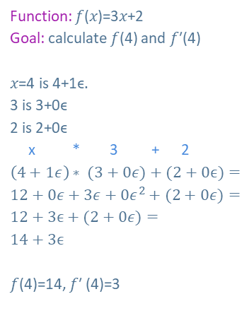
Calculating Gradients
Dual Numbers Example
Function: 𝑓(𝑥)=3𝑥+2
Goal: calculate 𝑓(4) and 𝑓′(4)
𝑥=4 is 4+1ϵ.
3 is 3+0ϵ
2 is 2+0ϵ
x * 3 + 2
$\left(4+1ε\right)∗ (3+0ε)+(2+0ϵ)=$
$12+0ε+3ε+0ε^{2}+(2+0ε)=$
$12+3ϵ+(2+0ε)=$
$14+3ϵ$
𝑓(4)=14, 𝑓′ (4)=3
Code Tip: Use like a float, in templated functions, with operator overloads.
Derivatives magically pop out.

Slide 22
Calculating Gradients
Exercise 3 – Dual Numbers
Exercises are at: https://github.com/electronicarts/cpp-ml-intro/tree/main/Exercises/3_DualNumbers
Implement +,-,* dual number operations to do gradient descent
Experiments and derivations of other dual number operations.

Slide 23
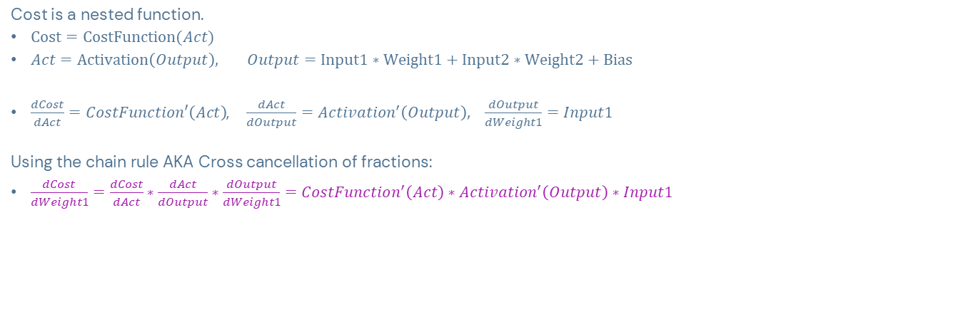
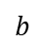
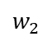
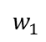
Calculating Gradients
Backpropagation – Pro Mode Gradients, Using The Chain Rule
Input 1
Cost is a nested function.
$\text{Cost}=\text{CostFunction}(Act)$
$Act=\text{Activation}\left(Output\right), Output=\text{Input}\text{1}∗\text{Weight}\text{1}+\text{Input}\text{2}∗\text{Weight}\text{2}+\text{Bias}$
$\frac{dCost}{dAct}=CostFunction′\left(Act\right)$, $\frac{dAct}{dOutput}=Activation^{′}\left(Output\right),$ $\frac{dOutput}{dWeight1}=Input1$
Using the chain rule AKA Cross cancellation of fractions:
$\frac{dCost}{dWeight1}=\frac{dCost}{dAct}∗\frac{dAct}{dOutput}∗\frac{dOutput}{dWeight1}=CostFunction^{′}\left(Act\right)∗Activation^{′}\left(Output\right)∗Input1$
$$w_{1}$$
Output
$$b$$
Input 2
$$w_{2}$$

Slide 24
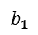
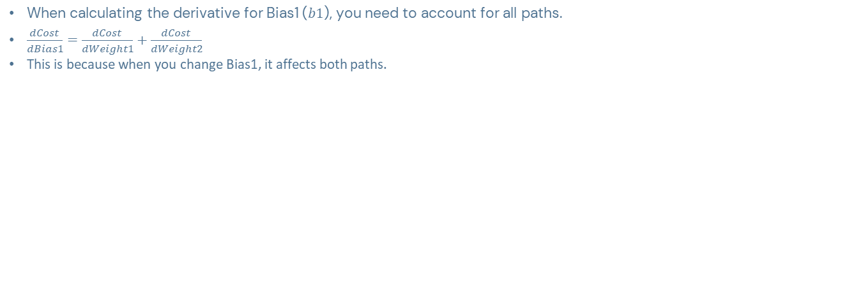


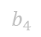
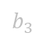
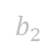
Calculating Gradients
Backpropagation – Hidden Layers Have Multiple Paths
$$b_{1}$$
Hidden1 A
$$w_{1}$$
$$b_{3}$$
Hidden2 A
When calculating the derivative for Bias1 ($b1$), you need to account for all paths.
$\frac{dCost}{dBias1}=\frac{dCost}{dWeight1}+\frac{dCost}{dWeight2}$
This is because when you change Bias1, it affects both paths.
$$w_{2}$$
$$w_{3}$$
Hidden1 B
Hidden2 B
$$b_{2}$$
$$w_{4}$$
$$b_{4}$$

Slide 25
Calculating Gradients
Exercise 4 – Back Propagation
Exercises are at: https://github.com/electronicarts/cpp-ml-intro/tree/main/Exercises/4_Backprop
Use the chain rule to get the derivative of a nested function

Slide 26
Calculating Gradients
Gradient Methods Comparison
Note: You can mix these! E.g. Get a f’(x) with finite differences,
then use that in backprop.
Finite Differences
Pro: You don’t need to know anything about internals of y=f(x)
Con: very slow to evaluate f at many locations.
Con: Only approximates derivatives and requires tuning an epsilon.
Dual Numbers
Pro: Exact derivatives
Meh: y=f(x) needs to be templated to take dual numbers
Con: Also very slow, and takes a lot of memory. One float per derivative!
Backpropagation
Pro: Very Fast, exact derivatives
Con: Needs deep integration and knowledge of y=f(x) to apply chain rule at each step.

Slide 27
Recipe For Recognizing Hand Drawn Digits

Slide 28
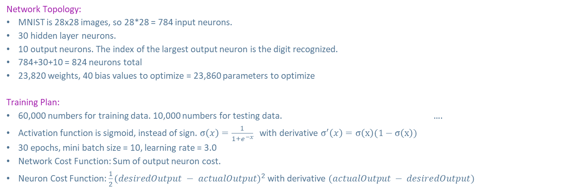
Recognizing Hand Drawn Digits
Training Recipe
Network Topology:
MNIST is 28x28 images, so 28*28 = 784 input neurons.
30 hidden layer neurons.
10 output neurons. The index of the largest output neuron is the digit recognized.
784+30+10 = 824 neurons total
23,820 weights, 40 bias values to optimize = 23,860 parameters to optimize
Training Plan:
60,000 numbers for training data. 10,000 numbers for testing data. ….
Activation function is sigmoid, instead of sign. $σ\left(x\right)=\frac{1}{1+e^{−x}}$ with derivative $σ^{′}\left(x\right)=σ\left(x\right)(1−σ\left(x\right))$
30 epochs, mini batch size = 10, learning rate = 3.0
Network Cost Function: Sum of output neuron cost.
Neuron Cost Function: $\frac{1}{2}(desiredOutput − actualOutput)^{2}$ with derivative $(actualOutput − desiredOutput)$

Slide 29
Recognizing Hand Drawn Digits
Training Results
95.27% accuracy on the 10,000 testing data images
Finite differences:
23,860 evaluations (double for central differences) across 18 cores, skipping input weights where input is 0.
Training time: Forward: 6 hours. Central: 11.5 hours.
Dual Numbers:
Implemented a “sparse dual number” class (busted the stack with locals!), pooled stack allocator, and more.
Training time: 28.5 hours
Backprop:
Training time: 90 seconds.
Would be fun to try these on GPU…

Slide 30
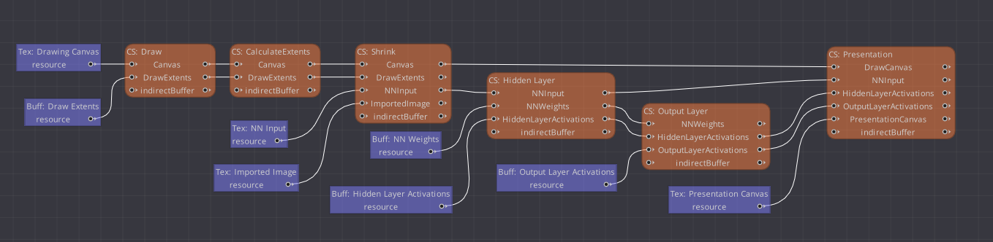


Recognizing Hand Drawn Digits
DX12 Demo Render Graph
Run Neural Net
93KB
Only “Hidden Layer” and “Output Layer” compute shaders are running the network, the rest is UI.
NN Weights = 93KB float buffer.
Training and Demo code at: https://github.com/electronicarts/cpp-ml-intro/

Slide 31
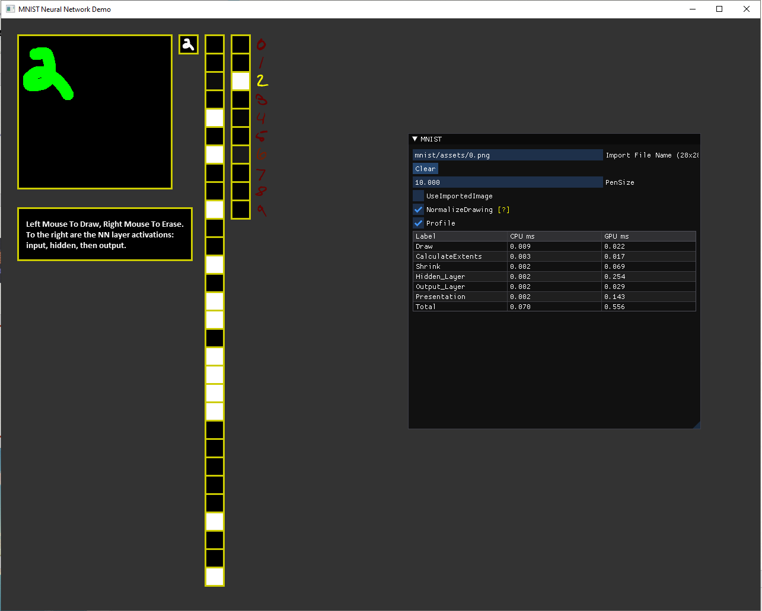

Recognizing Hand Drawn Digits
DX12 Demo In Action! (RTX 3090)
283μs!

Slide 32
ML Introduction For Game Devs
Closing
This stuff isn’t so scary!
Backprop is nice but isn’t the only way.
Training is slow but using trained data (inference) can be extremely fast. Very runtime friendly.
Where To Go From here?
Try adding momentum, or implement ADAM
Try another activation function, like relu or selu
Try a convolutional neural network
Cifar-10 images instead of MNIST digits (https://www.cs.toronto.edu/~kriz/cifar.htm)
ONNXRuntime with EA wrapper!
There are many Game Dev experts at EA and many ML experts too. If we can bridge the gap, we can make amazing things happen!
#machine-learning-se-sig
Training code, demo code, and exercises at https://github.com/electronicarts/cpp-ml-intro/

Slide 33
Thank you!
Check out the Machina AI site for more info.

